Slide 1
SLAM
Abstraction
Roderick Bloem

Slide 2
The Approach

Slide 3
Abstraction
Represent complex program by simple program
  original program is concrete, simple one is abstract
Construction: if abstraction correct, then original correct
  But: abstract program may fail even if the original is correct
  We will look at refinement later
Whenever we can not make a decision with certainty, we allow all possibilities

Slide 4
Predicate Abstraction
Replace variables by predicates. E.g., instead of x have the predicates
  b, meaning {x>0},
  c: {x<0},
  d: {x==0}
or replace x and y by
  e: {x==y}, or by
  f: {x<y}, or by
  g: {2x – y < 0},

Slide 5
Predicate Abstraction
Example: keep only the lowest bit of a number.
b: {x is odd}
assert(x!=38) becomes assert(b)
assert(b) is stricter:
  if assert(x!=38) fails then assert(b) also fails
  But not vice-versa
What about
If-then-else?
Assignments?
Construct abstract programs one statement at a time
Abstracting statement does not require full program analysis

Slide 6
Abstraction of Conditional
We use * to denote a nondeterministic value
Original Program
if(x == 5) then
S1
else
S2
fi
Abstract Program b = {x=5}
if(b?*:F) then
S1
else
S2
fi

Slide 7
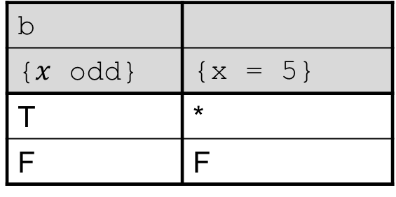
Abstraction of Conditional
We use * to denote a nondeterministic value
b
 | {x = 5}
T | *
F | F
Original Program
if(x == 5) then
S1
else
S2
fi
Abstract Program b = {x odd}
if(b?*:F) then
S1
else
S2
fi

Slide 8
Abstraction of Conditional
We use * to denote a nondeterministic value
b
 | {x = 5}
T | * (e.g., x=3, x=5)
F | F
Original Program
if(x == 5) then
S1
else
S2
fi
Abstract Program (b = {x odd})
if(b?*:F) then
S1
else
S2
fi
Note:
b=false is the same as x even, which implies x!=5.
b=true means that x is odd, which means x may or may not be 5

Slide 9
Abstraction Example
For automatic abstraction, let’s first check some basics.
Let’s say we have one predicate:
b = {x ≤ y}
How do we abstract
x := y?
y := y+1?

Slide 10
Computing Abstraction
b = {x ≤ y}
Use Hoare’s weakest precondition
{y ≤ y}
x : = y
{x ≤ y}
Thus, y≤y before the statement iff x≤y after
x := y is abstracted to b = true

Slide 11
Computing Abstraction
b = {x ≤ y}
Use Hoare’s weakest precondition
{y ≤ y}
x : = y
{x ≤ y}
Thus, y≤y before the statement iff x≤y after
x := y is abstracted to b = true

Slide 12
Computing Abstraction
Now for y := y + 1.
b = {x ≤ y}
{x ≤ y + 1}
y := y + 1
{x ≤ y}
Thus, x ≤ y + 1 before iff x ≤ y after.
In which cases can we guarantee x ≤ y+1?
We don’t have enough information to decide whether x≤y+1 before, so we approximate.
abstraction: b = b ? T : *;
b | b’
{x ≤ y} | {x ≤ y+1}
T | T
F | *

Slide 13
Computing Abstraction
Now for y := y + 1.
{x ≤ y + 1}
y := y + 1
{x ≤ y}
Thus, x ≤ y + 1 before iff x ≤ y after.
In which cases can we guarantee x ≤ y+1?
We don’t have enough information to decide whether x≤y+1 before, so we approximate.
abstraction: b = b ? T : *;
b | b’
{x ≤ y} | {x ≤ y+1}
T | T
F | * (e.g. (x,y)=(9,3) or (3,3))

Slide 14
Conservative Abstraction
Let us abstract x by b:{x < 0}.
We may loose some information Example:
x = -2;
x = x + 1;
assert(x<0);
is abstracted statement-by statement-to
b = true;
b = b ? * : f
alse;
assert(b);
The abstraction is conservative: bugs are preserved (but new bugs may occur).

Slide 15
Conservative Abstraction
Let us abstract x by b:{x < 0}.
We may loose some information Example:
x = -2;
x = x + 1;
assert(x<0);
is abstracted statement-by statement-to
b = true;
b = b ? * : false;
assert(b);
The abstraction is conservative: bugs are preserved (but new bugs may occur).

Slide 16
Multiple Predicates
Two predicates: b={x ≤ y} and c={x=y+1}
preconditions:
b | c |  | b’ | c’
x≤y | x=y+1 |  | x≤y+1 | x=y+2
T | T | X
T | F | a ≤ b | T | F
F | T | a=b+1 | T | F
F | F | a>b+1 | F | *

Slide 17
Multiple Predicates
Two predicates: b={x ≤ y} and c={x=y+1}
preconditions:
{x ≤ y + 1}
y := y + 1
{x ≤ y}
{x = y + 2}
y := y + 1
{x = y+1}
y:=y+1 is abstracted to
(b, c) :=
(b||c ? T : F,
b||c ? F : *)
In general, simultaneous assignments are needed for abstract statements
b | c |  | b’ | c’
x≤y | x=y+1 |  | x≤y+1 | x=y+2
T | T | X | T | F
T | F | a ≤ b | T | F
F | T | a=b+1 | T | F
F | F | a>b+1 | F | *

Slide 18
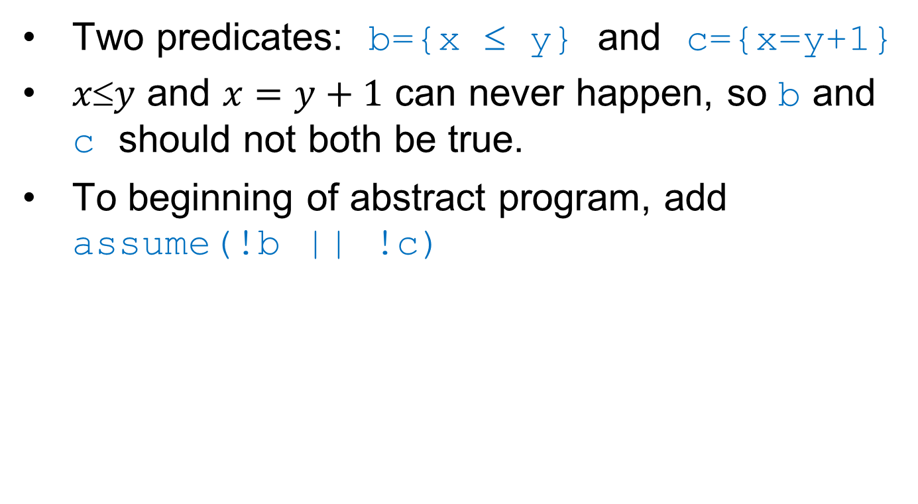
Multiple Predicates
Two predicates: b={x ≤ y} and c={x=y+1}
$xy$ and $x=y+1$ can never happen, so b and c should not both be true.
To beginning of abstract program, add assume(!b || !c)

Slide 19
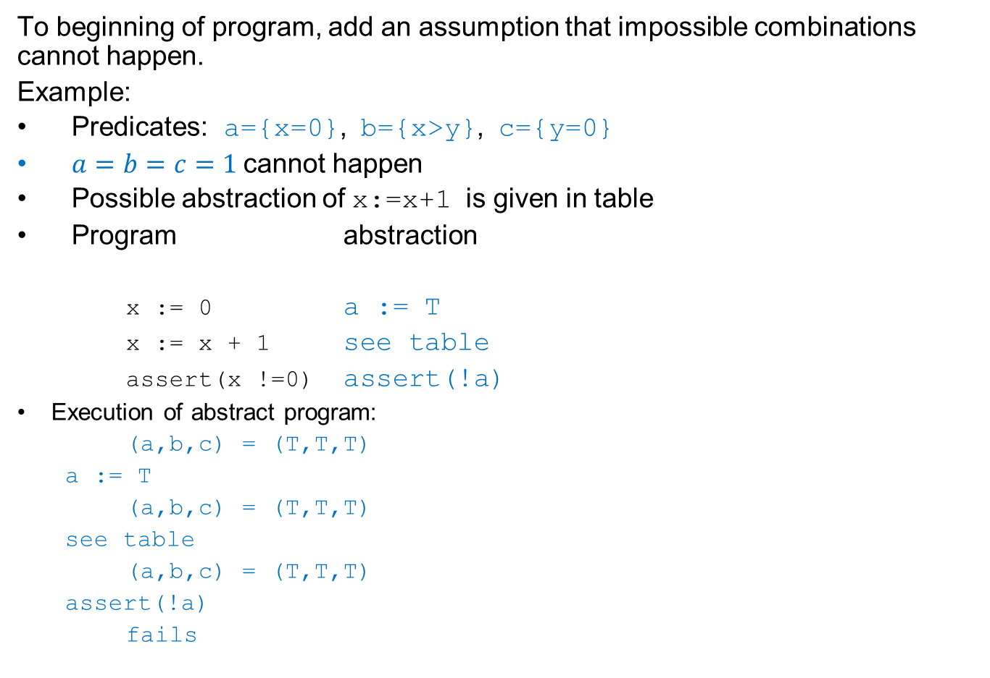
Multiple Predicates
To beginning of program, add an assumption that impossible combinations cannot happen.
Example:
Predicates: a={x=0}, b={x>y}, c={y=0}
$a=b=c=1$cannot happen
Possible abstraction of x:=x+1 is given in table
Program abstraction
x := 0 a := T
x := x + 1 see table
assert(x !=0) assert(!a)
Execution of abstract program:
  (a,b,c) = (T,T,T)
  a := T
  (a,b,c) = (T,T,T)
  see table
  (a,b,c) = (T,T,T)
  assert(!a)
  fails
a | b | c | a’ | b’ | c’
x=0 | x>y | y=0 | x=-1 | x-1>y | y=0
F | F | F | * | * | F
F | F | T | * | * | T
F | T | F | * | * | F
F | T | T | * | * | T
T | F | F | * | * | F
T | F | T | * | T | T
T | T | F | * | * | F
T | T | T | T | T | T

Slide 20

Multiple Predicates
To beginning of program, add an assumption that impossible combinations cannot happen.
Example:
Predicates: a={x=0}, b={x>y}, c={y=0}
$a=b=c=1$cannot happen
Possible abstraction of x:=x+1 is given in table
Program abstraction
assume(!(a && b && c))
x := 0 a := T
x := x + 1 see table
assert(x !=0) assert(!a)
Execution of abstract program:
  (a,b,c) = (T,T,T)
  a := T
  (a,b,c) = (T,T,T)
  see table
  (a,b,c) = (T,T,T)
  assert(!a)
  fails
a | b | c | a’ | b’ | c’
x=0 | x>y | y=0 | x=-1 | x-1>y | y=0
F | F | F | * | * | F
F | F | T | * | * | T
F | T | F | * | * | F
F | T | T | * | * | T
T | F | F | * | * | F
T | F | T | * | T | T
T | T | F | * | * | F
T | T | T | T | T | T

Slide 21
Another Example
done = 0;
while(done == 0){
if(x != 0)
x--;
else
done++;
}
assert(x == 0);
How do you argue that the program is correct?
Which predicates do you need to prove that?
Notes:
You can do it with b:(done==0) and c: (x==0). Draw a graph of the state space.

Slide 22
Function Calls
int y;
f(){
h(y);
}
void h(int z){
y = z;
}
bool b; // y>0
f(){
}
void h(bool c){ // c: z =0
}

Slide 23
Function Calls
int y;
f(){
h(y);
}
void h(int z){
y = z;
}
bool b; // y>0
f(){
h(b ? F : *)
}
void h(bool c){ // c: z =0
b = c ? F : *;
}

Slide 24
Abstraction
Tricky: find the proper abstraction!
  You use the counterexamples, but how?
  You can do it by hand
  You can try to do it automatically
Automatically finding the proper abstraction cannot always work. Why not?

Slide 25
Precisely: assignment
Original: x:= e
Predicates p1,…,pn.
Suppose we have
{qi}
x := e;
{pi}
Let ai be the disjunction of assignments to p1…pn that imply qi.
let bi be the disjunction of assignments to p1…pn that imply ¬qi.
x := e is replaced by
simultaneous
p1 = a1 ? T : b1 ? F : *
…
pn = an ? T : bn ? F : *
end simultaneous
example
Assignment: b := b+1
Predicates: p1 = {a ≤ b} and p2 = {a=b+1}
{a ≤ b + 1} {a = b + 2}
b := b + 1 b := b + 1
{a ≤ b} {a = b + 1}
Look at the table: row TT, TF, and FT have a T in column a≤b and TT and FF have an F in that column. Therefore:
p1 ∨ p2 implies a ≤ b + 1
(p1∧p2)∨(¬p1∧¬p2) implies a > b + 1
(note: false implies anything)
For the 2nd predicate:
p1 ∧ p2 implies a = b+2
p1 ∨ ¬p2 implies a ≠ b+2
b:=b+1 is abstracted to
simultaneous
{a≤b} := p1||p2 ? T : p1==p2 ? F : *
{a=b+1} := p1&&p2 ? T : p1!=p2 ? F : *
end
p1 | p2
a≤b | a=b+1 |  | a≤b+1 | a=b+2
T | T | ✗ | T/F | T/F
T | F | a≤b | T | F
F | T | a=b+1 | T | F
F | F | a>b+1 | F | *
(Cf. same example on an earlier slide)

